Slide 1
Threads (ریسمان، نخ)
Hamid R. Zarandi
h_zarandi@aut.ac.ir

Slide 2
Definition
A basic unit of CPU utilization
Private: Thread ID, program counter, register set, stack
Shared: code section, data section, OS resources (IO & file)
Examples:
Web browsers
Word processors
Database engines
RPC!
Versus Process:
Time consuming
Resource intensive

Slide 3
Web server application

Slide 4
Advantages of using threads
Responsiveness
Allowing a program to continue running even part of it is blocked or lengthy
Resource sharing
Memory, resources
Economy
Fast
Scalability
Threads may be running in parallel on processing cores

Slide 5
Multicore programming
Multicore or multiprocessor systems putting pressure on programmers, challenges include:
Dividing activities
Balance
Data splitting
Data dependency
Testing and debugging
Parallelism implies a system can perform more than one task simultaneously
Concurrency supports more than one task making progress
Single processor / core, scheduler providing concurrency

Slide 6

Multicore programming
Concurrent execution on single-core system:
Parallelism on a multi-core system:

Slide 7
Types of parallelism
Types of parallelism
Data parallelism
Task parallelism
As # of threads grows, so does architectural support for threading
CPUs have cores as well as hardware threads
Consider Oracle SPARC T4 with 8 cores, and 8 hardware threads per core

Slide 8
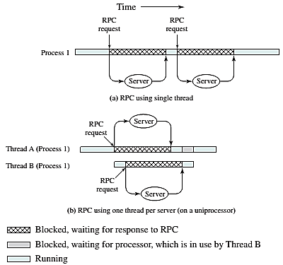
RPC using threads

Slide 9
User threads and kernel threads
User threads - management done by user-level threads library
Three primary thread libraries:
POSIX Pthreads (kernel-level lib, user-level lib)
Windows threads (kernel-level lib)
Java threads (kernel-level lib)
Kernel threads - Supported by the Kernel
Asynchronous vs. synchronous threading
Parent & child threads

Slide 10
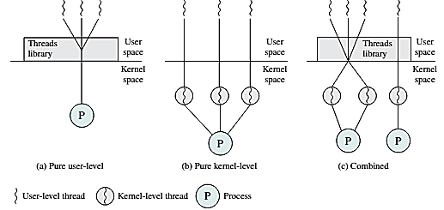
User level vs. kernel level threads

Slide 11
Multithreading models
Many-to-One
One-to-One
Many-to-Many

Slide 12
Many-to-one
Many user-level threads mapped to single kernel thread
One thread blocking causes all to block
Multiple threads may not run in parallel on multicore system because only one may be in kernel at a time
Few systems currently use this model
Examples:
Solaris Green Threads
GNU Portable Threads
Used in very few systems.

Slide 13
One-to-one
Each user-level thread maps to kernel thread
Creating a user-level thread creates a kernel thread
More concurrency than many-to-one
Number of threads per process sometimes restricted due to overhead
Examples
Windows
Linux
Solaris 9 and later

Slide 14
Many-to-many model
Allows many user level threads to be mapped to many kernel threads
Allows the operating system to create a sufficient number of kernel threads
Two-level Model:
Similar to M:M, except that it allows a user thread to be bound to kernel thread

Slide 15
Thread operations and states
Spawn
When a new process is spawned, a thread for that process is also spawned
Block
When a thread needs to wait for an event, it will block
Unblock
When the event for which a thread is blocked occurs, the thread is moved to the Ready queue
Finish
When a thread completes, its register context and stacks are deallocate

Slide 16
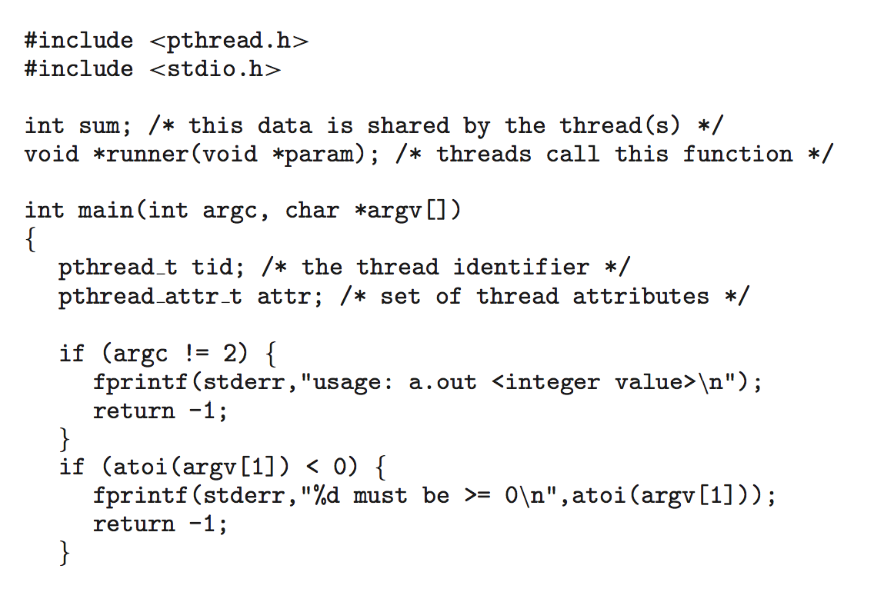

Pthread: POSIX thread

Slide 17
Pthreads code for joining 10 threads

Slide 18
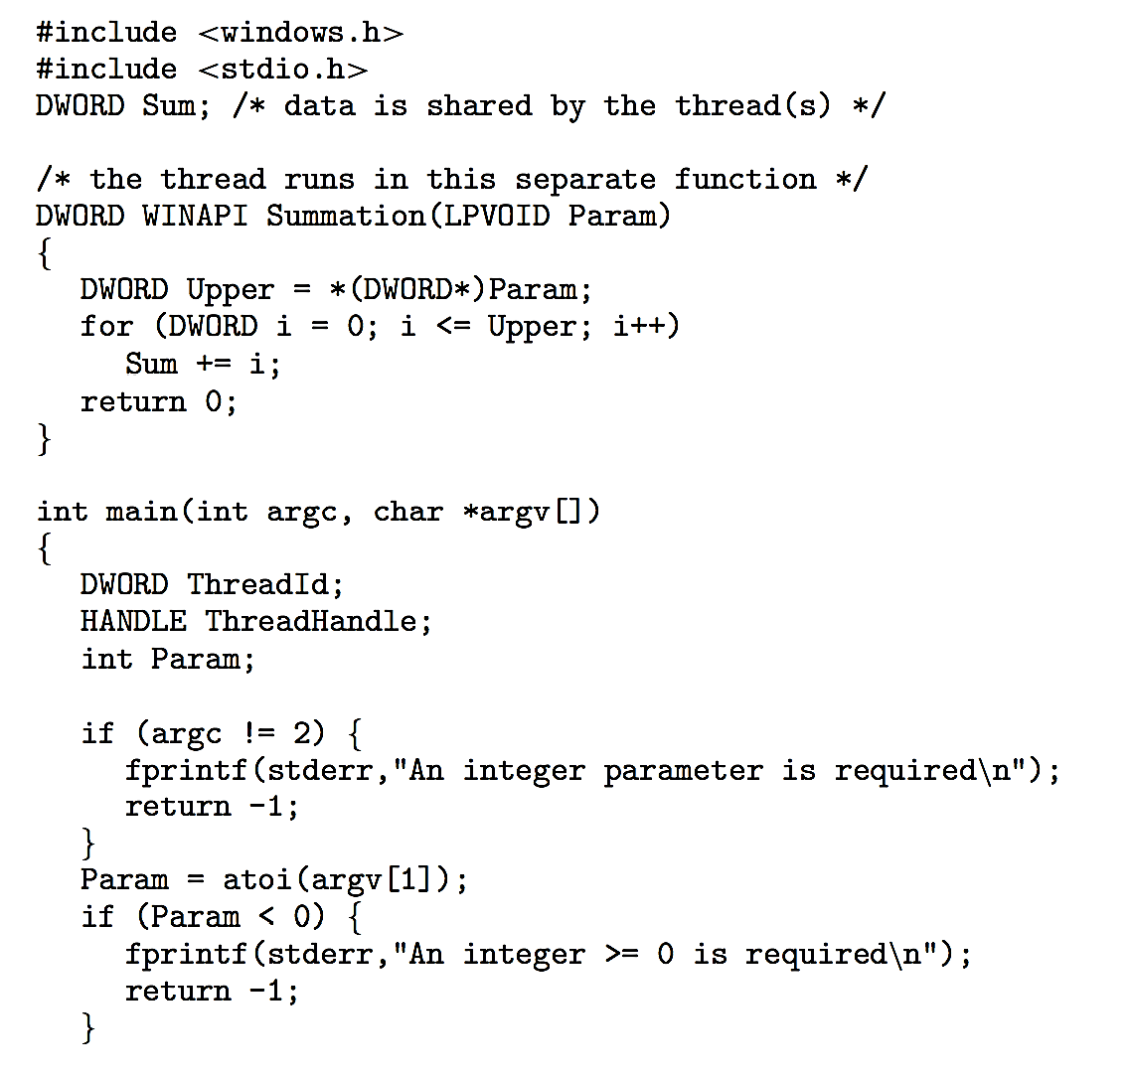
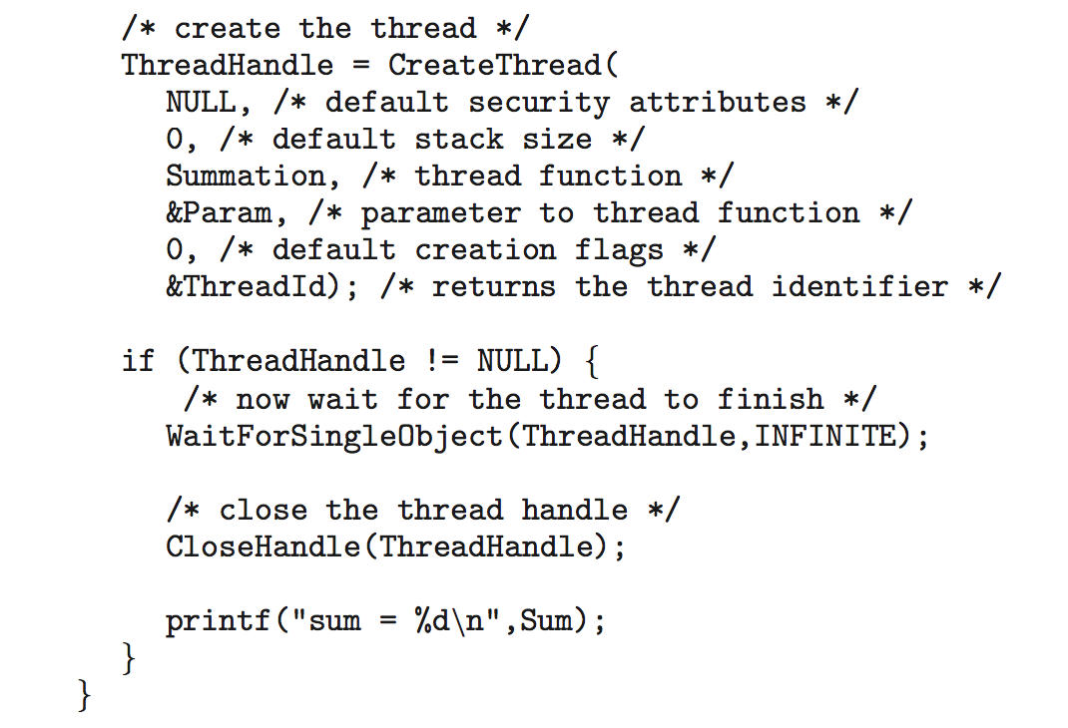
Windows multithread C program

Slide 19
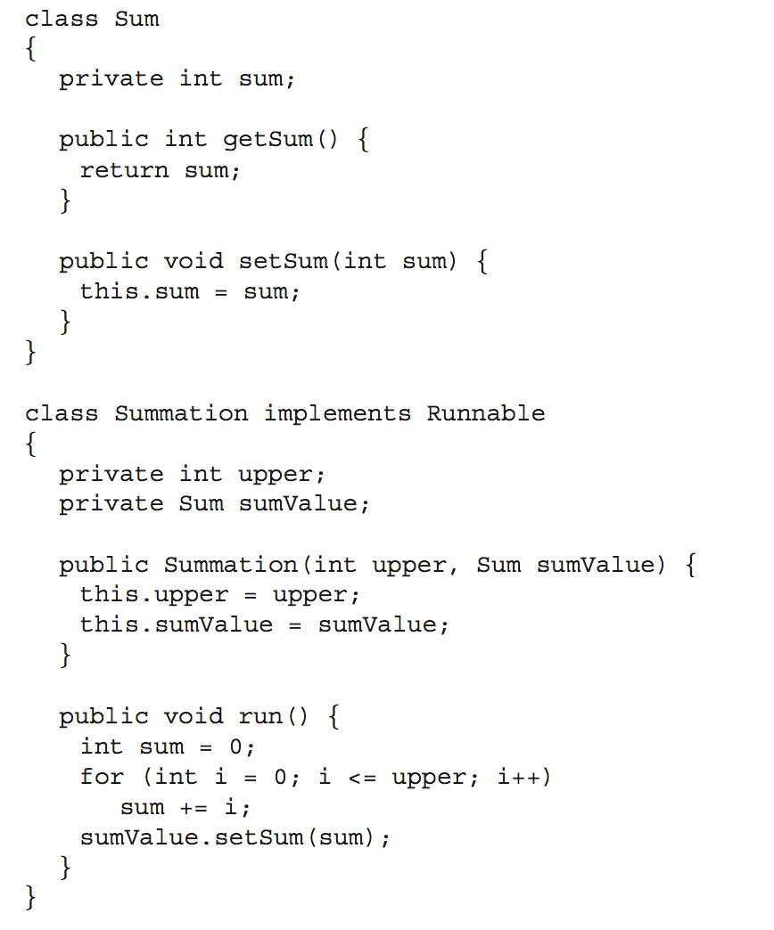
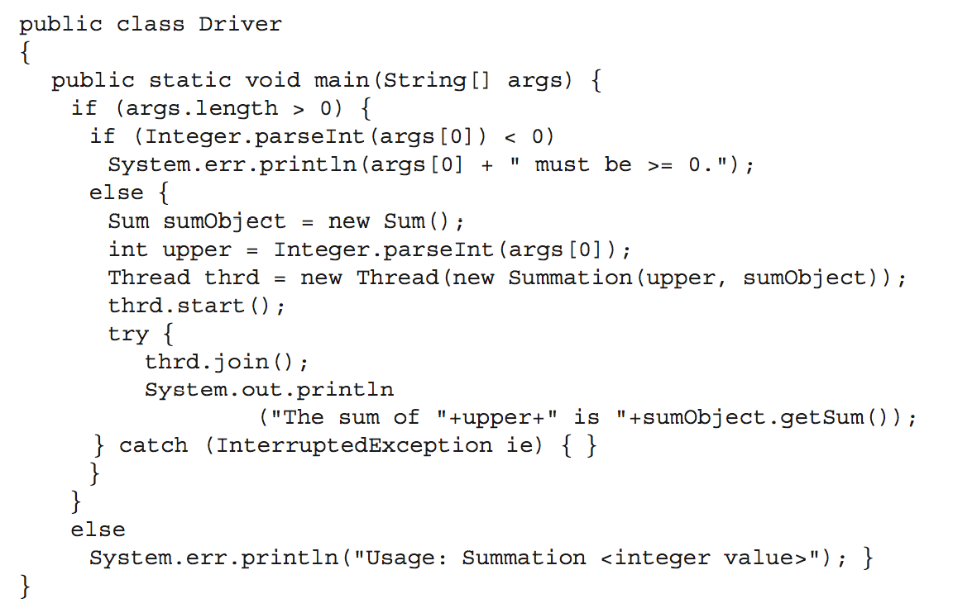
Java thread programming

Slide 20
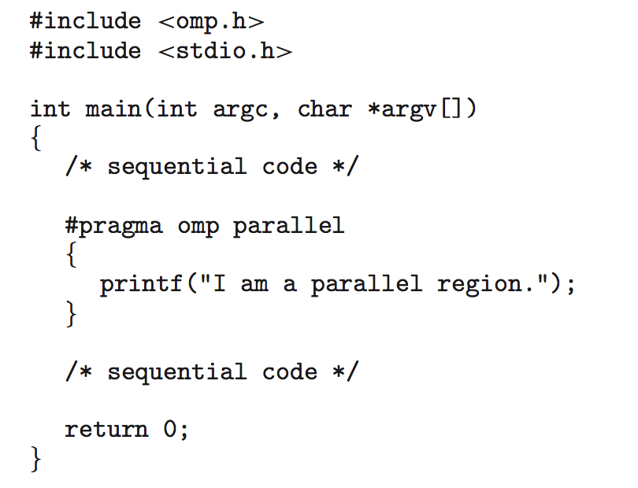
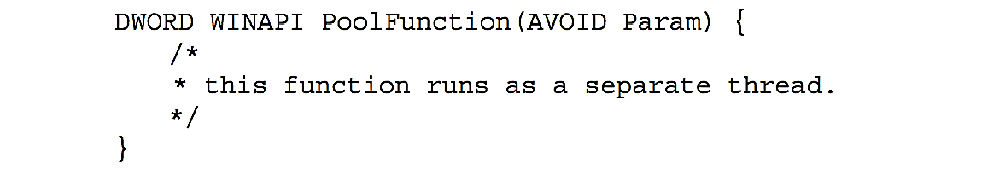
Implicit threading
Three methods explored
Thread Pools (Win)
OpenMP (C lib)
Grand Central Dispatch (Mac OS, iOS)
Block is in “^{ }” - ˆ{ printf("I am a block"); }
#pragma omp parallel for for(i=0;i<N;i++) {
c[i] = a[i] + b[i];
}

Slide 21
Thread-local storage
Thread-local storage (TLS) allows each thread to have its own copy of data
Useful when you do not have control over the thread creation process (i.e., when using a thread pool)
Different from local variables
Local variables visible only during single function invocation
TLS visible across function invocations
Similar to static data
TLS is unique to each thread

Slide 22
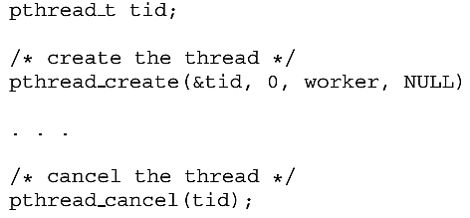
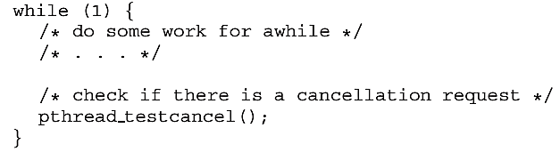
Thread termination
Thread cancelation
Asynchronous cancellation
Deferred cancellation
Who is “target thread”?

Slide 23
Windows threads data structures
Implements the one-to-one mapping, kernel-level
Each thread contains
A thread id
Register set representing state of processor
Separate user and kernel stacks for when thread runs in user mode or kernel mode
Private data storage area used by run-time libraries and dynamic link libraries (DLLs)
The register set, stacks, and private storage area are known as the context of the thread
Data structures:
Execution thread block, kernel thread block and thread environment block

Slide 24
Linux threads
Linux refers to them as tasks rather than threads
Thread creation is done through clone() system call
clone() allows a child task to share the address space of the parent task (process)
Flags control behavior
struct task_struct points to process data structures (shared or unique)

Slide 25

Questions?

